Slide 1
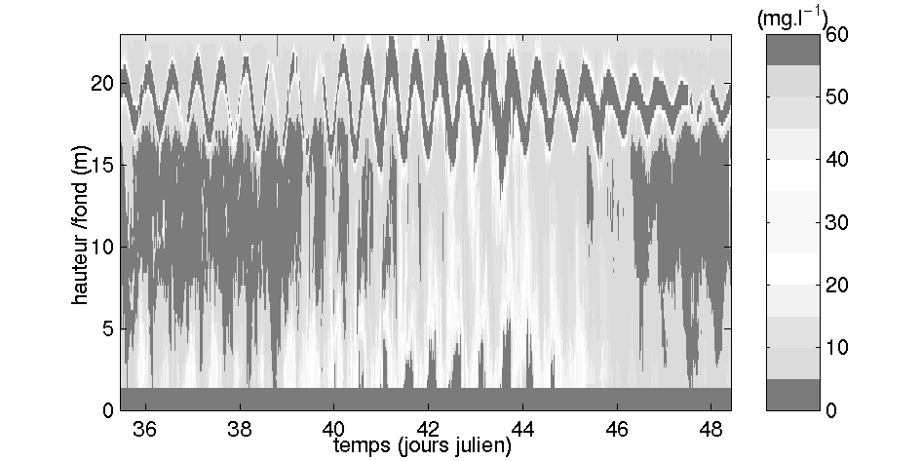
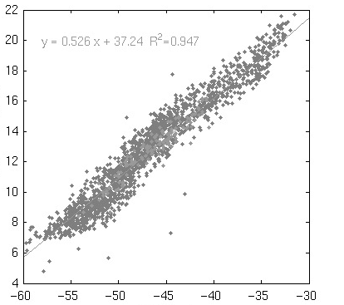
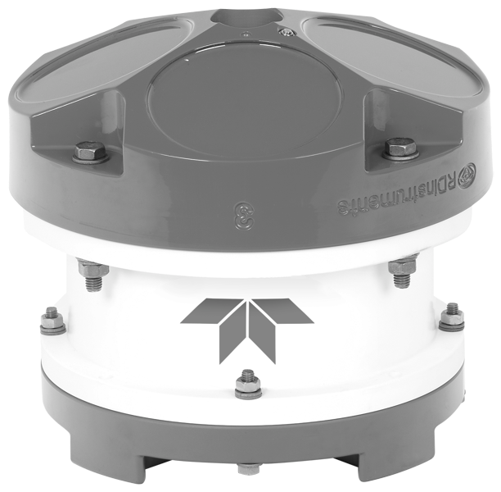
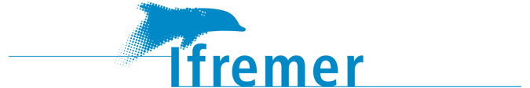
Estimating Suspended Solid Concentration from ADCP measurements
Romaric Verney / Caroline Tessier
romaric.verney@ifremer.fr
Skype : verney_ifr

Slide 2
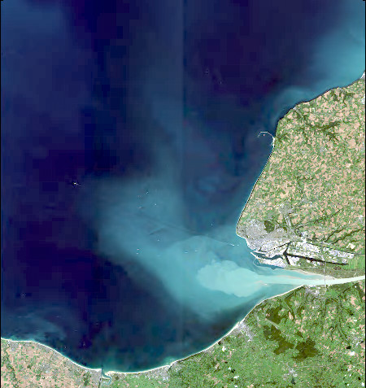
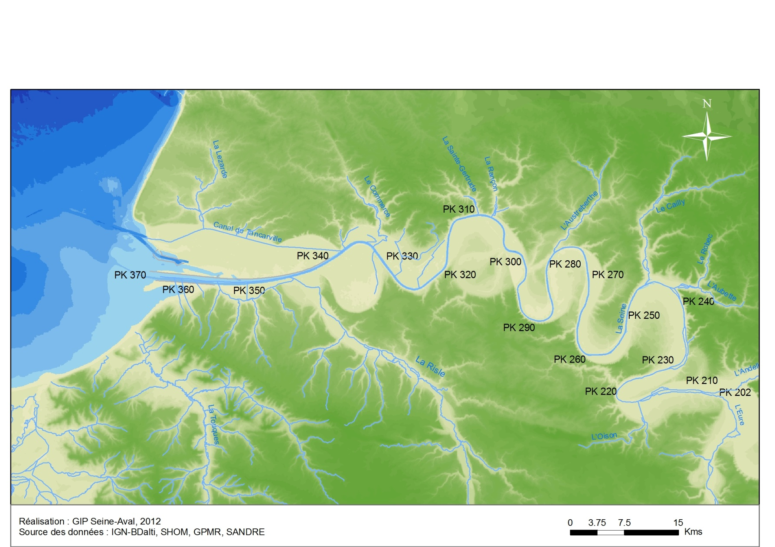
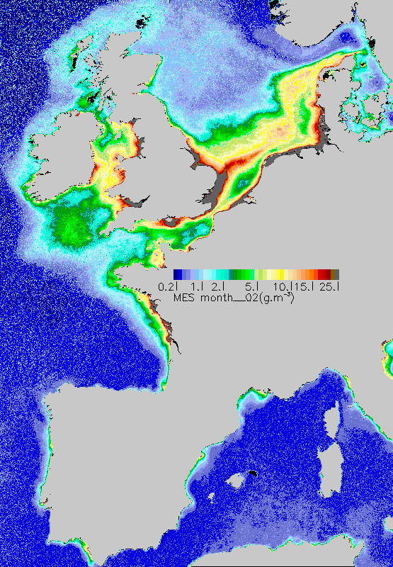

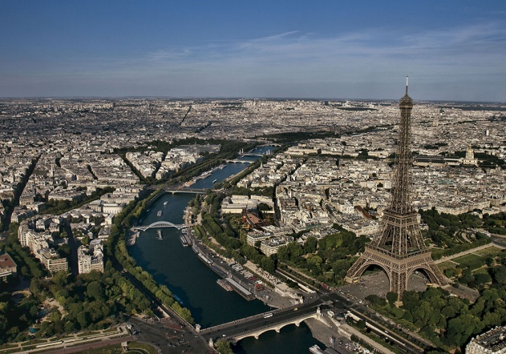
Observing sediment transport in estuaries and coastal seas
Tidal limit
© Yann Arthus Bertrand

Slide 3
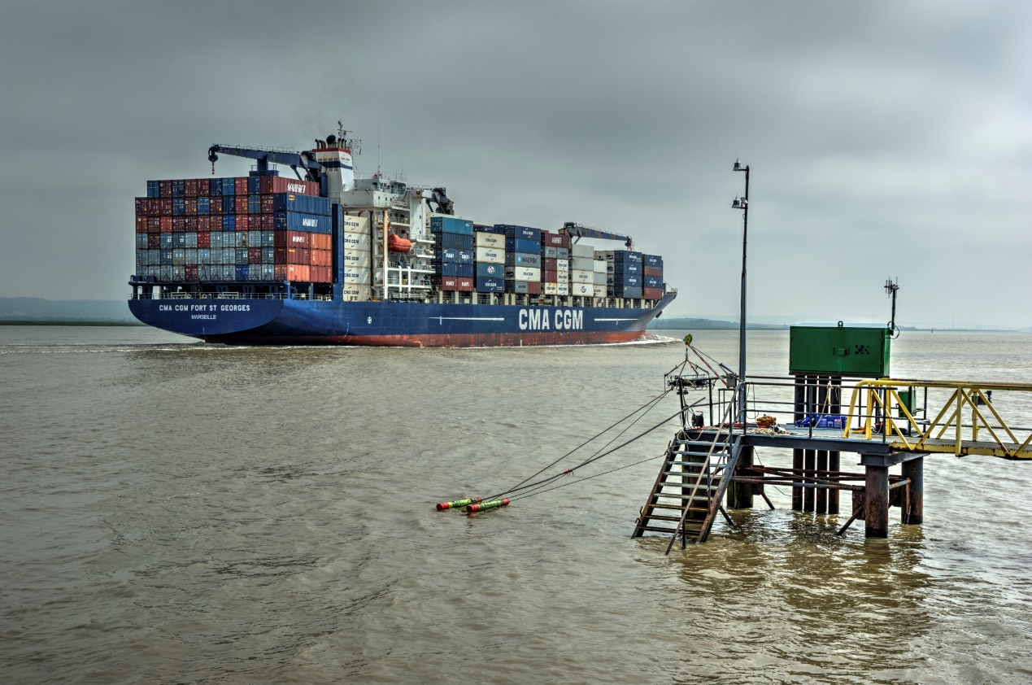
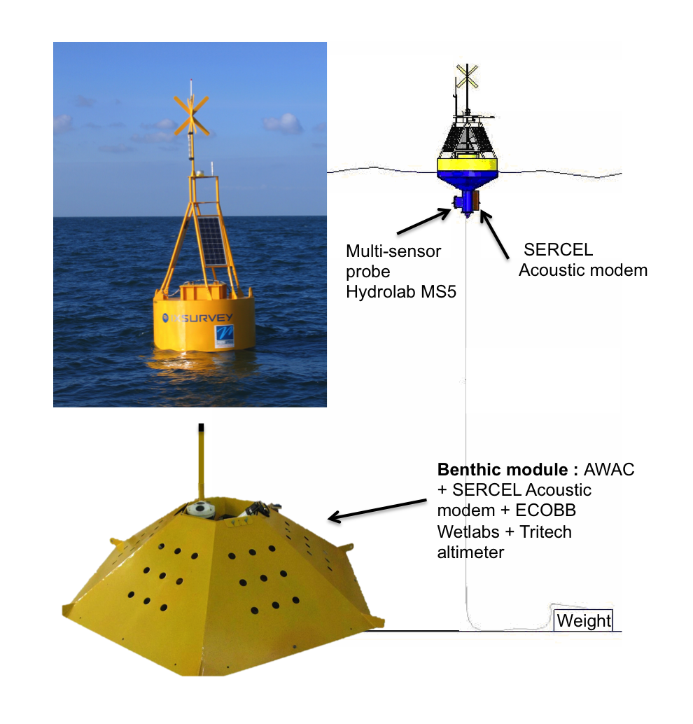
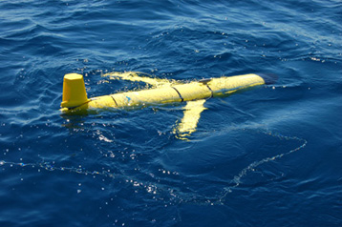
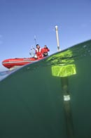
Platforms
[Cohesive] Sediment fluxes from land to open ocean
Monitoring station Estuary Banks
Buoys / Moorings
Gliders / Autonomous profilers
Optical systems (OBS-like) and Acoustic profilers (ADCP)
From O(0. 001) to O(0.1)g/l
Optical systems (OBS-like) and Acoustic profilers (ADCP)
From O(0. 001) to O(0.1)g/l
Optical systems (OBS-like)
From O(0. 01) to O(1)g/l
Long term (>1y)
Long term (>1y)
Mid term (~1month)

Slide 4
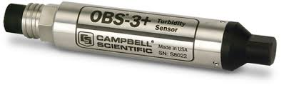
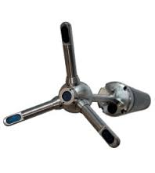
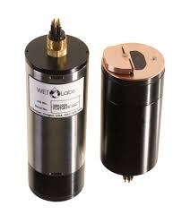
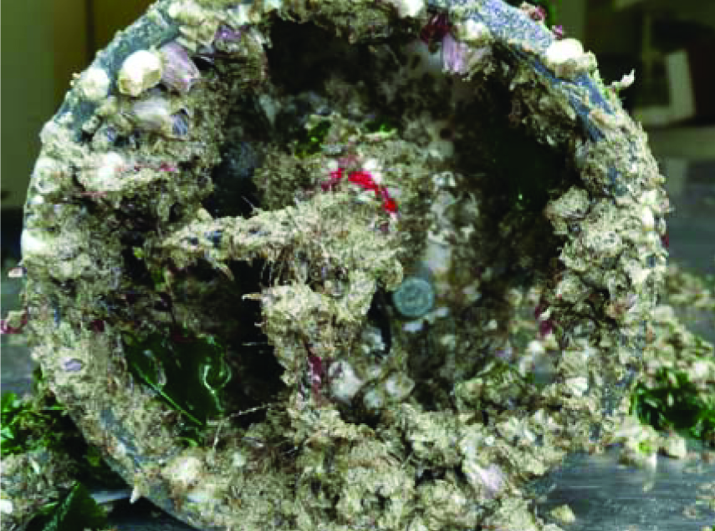
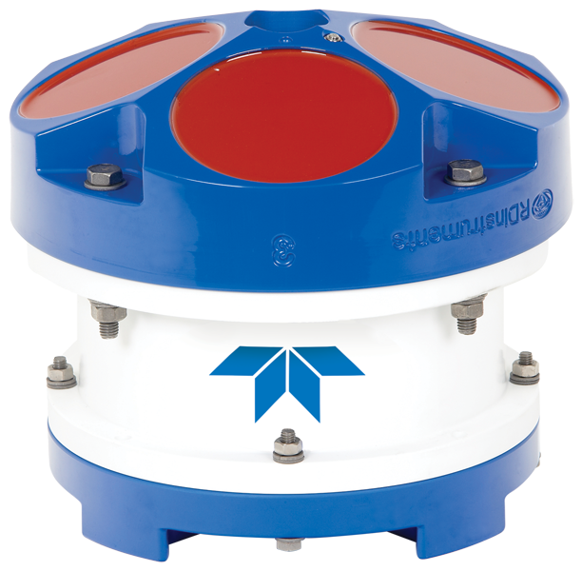
Acoustic Vs Optical sensors
Optical systems
Acouctic devices
Optical systems (OBS-like)
From O(0. 001) to O(1)g/l
High accuracy
Acoustic profilers (ADCP) – Velocimeter (ADVs)
From O(0. 001) to O(1)g/l
Lower accuracy
But : local measurements - Fooling
Sampling the full water column

Slide 5
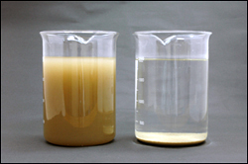
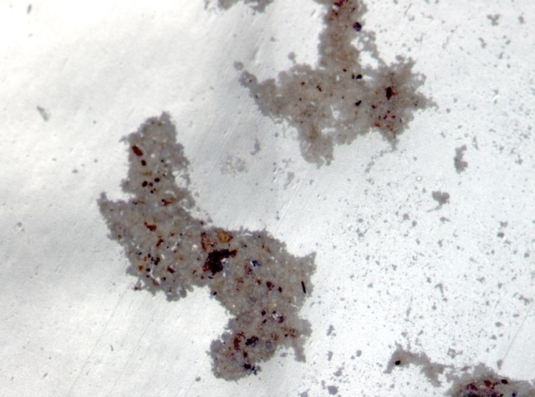
SSC / SPM concentration and acoustics
For optical systems : variability in sediment nature means variable calibration slopes
What consequences for acoustics?

Slide 6
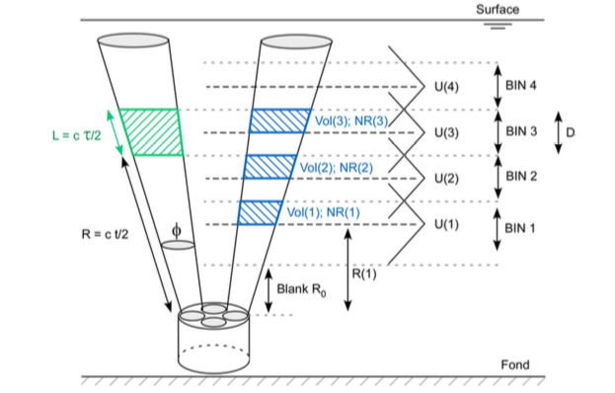
ADCP
Deines, 1999 : for BB ADCP, backscatter is evaluated in the second half of the bin

Slide 7
SSC and Acoustic sensors
Sonar equation : Deines, 1999 – Lurton, 2002) in dB
RL = SL - 2TL + TI
RL : received acoustic level – measured by the ADCP
SL : source level – emitted by the ADCP
TL : Transmission loss : due to the attenuation of the acoustic wave within the ambient environment
TI : Target index – related to SSC!

Slide 8
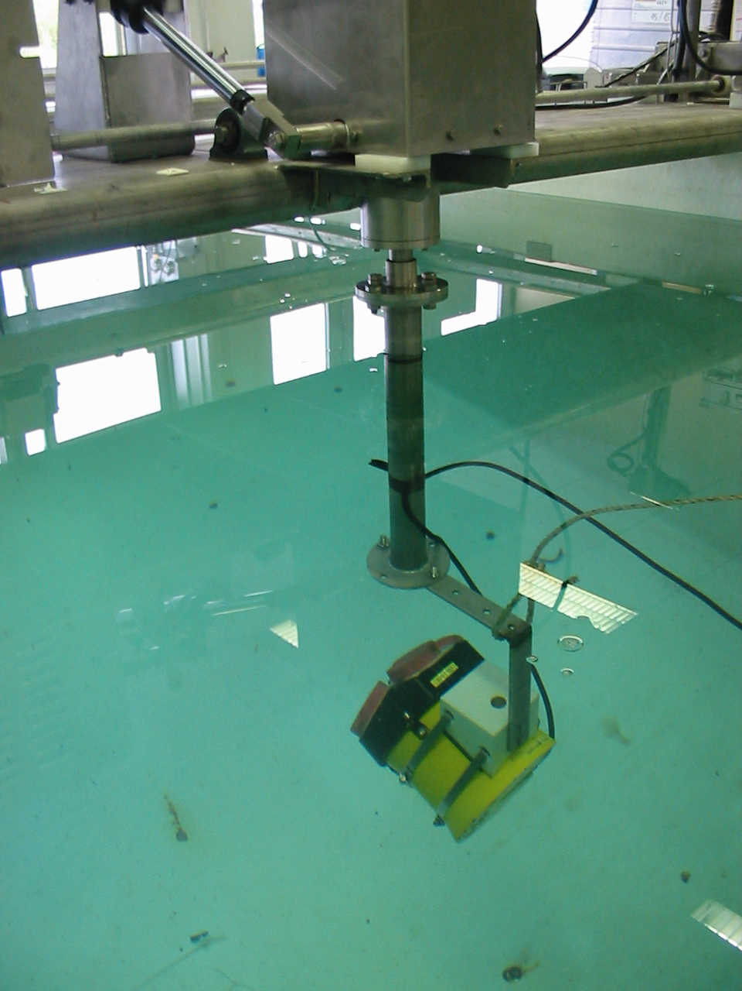
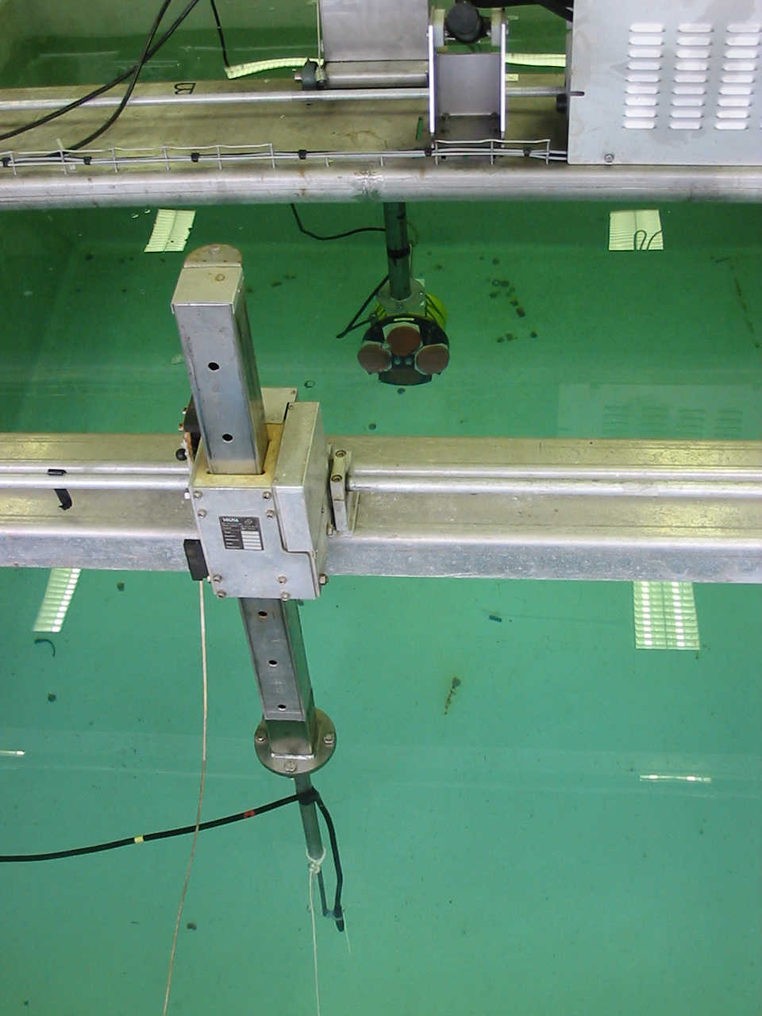
SSC and Acoustic sensors
RL = SL - 2TL + TI
RL : received acoustic level – measured by the ADCP
Use Manufacturer reports
2 options :
Make your own laboratory calibration

Slide 9
SSC and Acoustic sensors
RL = SL - 2TL + TI
RL : received acoustic level – measured by the ADCP
RL=N+K_{c}(E-E₀)
E in counts is directly measured by the ADCP : amplitude in RDI files
E0 is the reference level, below wich the ADCP is not working, N the associated acoustic pressure in dB
Ranges :
E
(counts)
N : 70 – 96
E₀ : 45-64
K_{c} : 0.35 – 0.55 but mainly 0.4-0.45 with an average value of 0.43
1/Kc
E₀
Attention, il existe une version révisée pour le calcul RL…si vous souhaitez l’utiliser en pro!
Hydrophone level
(dB_{/1µPa})
N

Slide 10
SSC and Acoustic sensors
RL = SL - 2TL + TI
SL : Source level
Obtained from laboratory calibrations or directly from the manufacturer
Our experience : for 1200kHz Sentinel : ranges from 216 to 218 dB…
Can vary with the battery voltage (a few dB from full charge to depletion)

Slide 11
SSC and Acoustic sensors
RL = SL - 2TL + TI
TL : Transmission loss
Spherical Spreading loss
Attenuation in the ambient environment

Slide 12
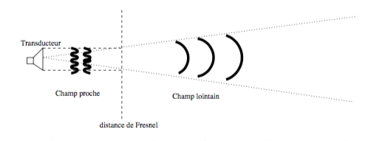
SSC and Acoustic sensors
RL = SL - 2TL + TI
TL : Transmission loss
Spherical Spreading loss
Transducer
Near Field
Far Field
Fresnel/Rayleigh distance R₀

Slide 13
SSC and Acoustic sensors
RL = SL - 2TL + TI
TL : Transmission loss
Attenuation
Water attenuation
Caused by water viscosity and biochemical interactions
Estimated from the formulation given by François and Garrison (1982)
T=10°C, S=34PSU, P=1atm

Slide 14
SSC and Acoustic sensors
RL = SL - 2TL + TI
TL : Transmission loss
Attenuation
Water attenuation

Slide 15
SSC and Acoustic sensors
RL = SL - 2TL + TI
TL : Transmission loss
Attenuation
Sediment attenuation
Viscous term α_{v}
+
Diffusion term α_{d}
Important for fine cohesive sediments

Slide 16
SSC and Acoustic sensors
RL = SL - 2TL + TI
TL : Transmission loss
Attenuation
Sediment attenuation
Viscous term α_{v}
Note here M is what we look for : SSC in g/l
Need to know the characteristics of suspended sediments

Slide 17
SSC and Acoustic sensors
RL = SL - 2TL + TI
TL : Transmission loss
Attenuation
Sediment attenuation
Diffusion term α_{d}
Note here M is what we look for : SSC in g/l
Need to know the characteristics of suspended sediments
σ_{tot} is the total scattering cross section, v_{s} is the volume of the representative particle in suspension and ρ_{s} its density

Slide 18
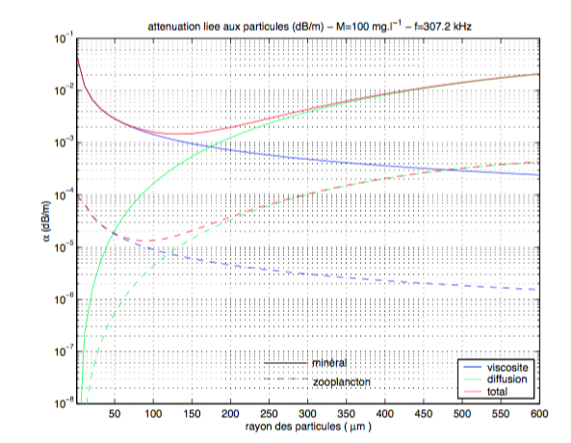
SSC and Acoustic sensors
RL = SL - 2TL + TI
TL : Transmission loss
Attenuation
Sediment attenuation
Particle radius (μm)

Slide 19
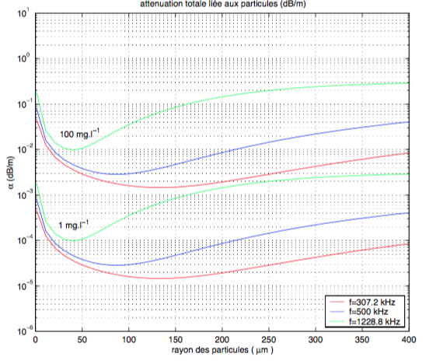
SSC and Acoustic sensors
RL = SL - 2TL + TI
TL : Transmission loss
Attenuation
Sediment attenuation
α_{s}>0.01dB/m
α_{s}~O(0.001)dB/m
Particle radius (μm)

Slide 20
SSC and Acoustic sensors
RL = SL - 2TL + TI
TI : Target index
σ : backscattering cross section, function of particle features such as particle size, density…
M is here the SSC we are looking for!
V is the volume insonified :
ouv=0.99° for a 1200kHz ADCP, WS is the bin size

Slide 21
SSC and Acoustic sensors
RL = SL - 2TL + TI
Summary….

Slide 22
SSC and Acoustic sensors
RL = SL - 2TL + TI
Summary….

Slide 23
SSC and Acoustic sensors
Main question : how estimating M?

Slide 24
SSC and Acoustic sensors
Main question : how estimating M?
Option 1 : empirical calibration
Requirements : expected SSC (or M) lower then 0.1 g/l
All terms excepted BI can be calculated, and BI known, and :

Slide 25
SSC and Acoustic sensors
Main question : how estimating M?
Option 1 : empirical calibration
Requirements : expected SSC (or M) lower then 0.1 g/l
Requirements : collecting reference concentration samples during ADCP measuements
Samples can be discrete water samples, but then they will be only few. Better to use calibrated optical turbiditimeter measurements:
Over a sufficiently long period if moored, or repeated in time (every months…)
Over the survey, enough to be representative of the turbidity range observed, with CTD casts.
Then searching for a linear relationship between BI and 10 log₁₀(M) such as :
10 log₁₀(M) =a*BI + b
In theory a should be 1 … but due to all uncertainteies associated to the calculation of all terms in the Sonar Equation, a can be different than 1.

Slide 26
SSC and Acoustic sensors
Main question : how estimating M?
Option 1 : empirical calibration
Tessier et al., 2008

Slide 27
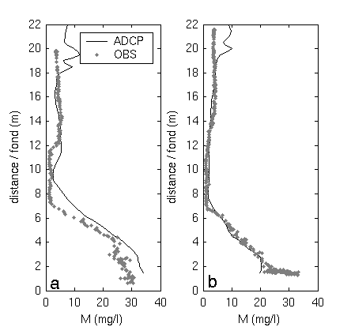
SSC and Acoustic sensors
Main question : how estimating M?
Option 1 : empirical calibration
Tessier et al., 2008
10log10 ( SSC [mg/l] )
from turbidimeter
Backscatter Index (dB)

Slide 28
SSC and Acoustic sensors
Main question : how estimating M?
Option 1 : empirical calibration
Tessier et al., 2008
Last step : apply the calibration of BI to all bins :
SSC
[mg/l]
free surface echo
SSC
[mg/l]
h (m)
Signal ADCP
time (days)

Slide 29
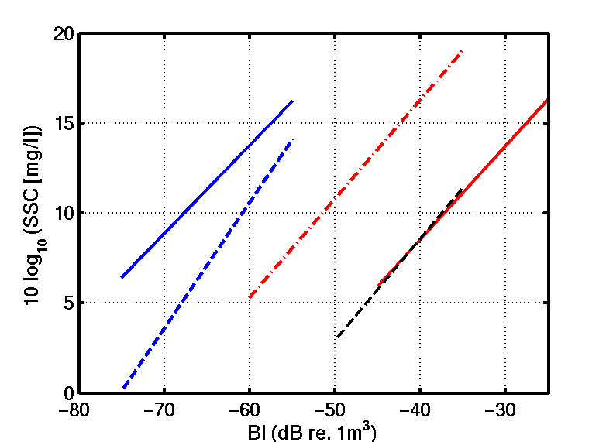
SSC and Acoustic sensors
Main question : how estimating M?
Option 1 : empirical calibration
Tessier et al., 2008
10 log₁₀(SSC) = a BI + b
1200 kHz
[mg/l]
--100
slope : 0.44 < a < 0.56
300 kHz : same range of BI
a = 0.7 in 2003
1200 kHz : different range of BI and SSC but inversed
2003 : spring, phytoplank.
2004 : autumn, detritic aggregates
2005 : winter, mineral particles, homogeneous size spectra
300 kHz
2005
-- 50
2004
-- 25
2004
-- 10
-- 5
2003
500 kHz
-- 2.5
2003
Backscatter Index (dB)

Slide 30
SSC and Acoustic sensors
Main question : how estimating M?
Option 2 : Direct calculation
Requirements : characteristics of suspended particles must be known or assumed
M < 100mg/l
M > 100mg/l
α_{s} can be neglected : « direct calculation »
α_{s} cannot be neglected : requires an iterative method
In both cases : particle size (α_{s}), density (ρ_{s}), sound velocity within the particle (c_{s}) must be known to calculate σ (backscattering cross section) and σ_{tot} (total scattering cross section)

Slide 31
SSC and Acoustic sensors
Main question : how estimating M?
Option 2 : Direct calculation
In both cases : particle size (α_{s}), density (ρ_{s}), sound velocity within the particle (c_{s}) must be known to calculate σ (backscattering cross section) and σ_{tot} (total scattering cross section)
Different models to calculate σ and σ_{tot}…
The most popular, adapted from Sheng and Hay (1988) by Thorne and Hanes (2002), but designed for sand particles
But in estuaries and coastal seas…suspended sediments are rarely sands and mostly fine cohesive sediments, aggregated in flocs (microflocs/macroflocs)

Slide 32
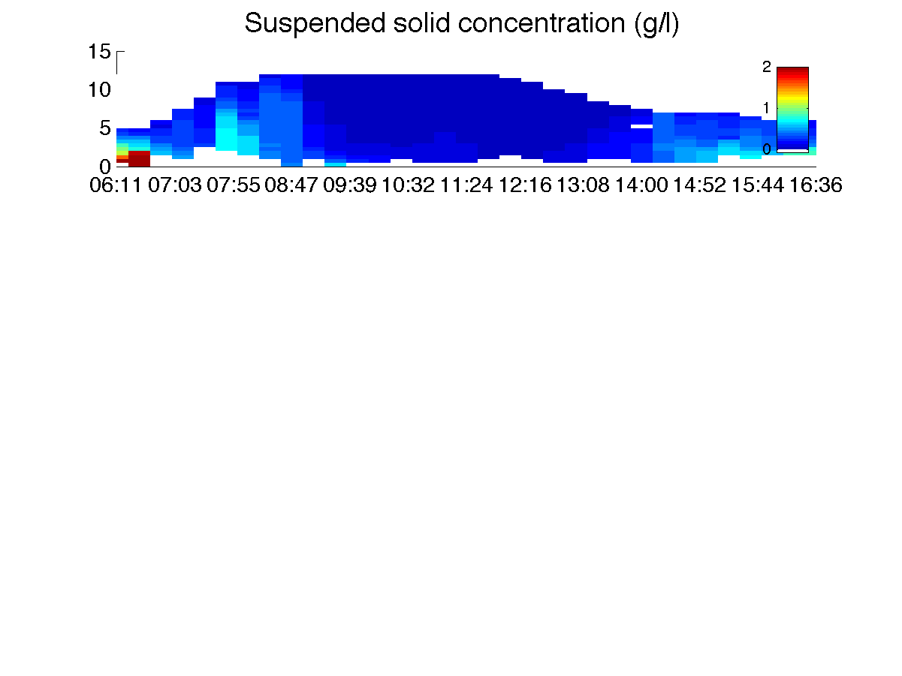
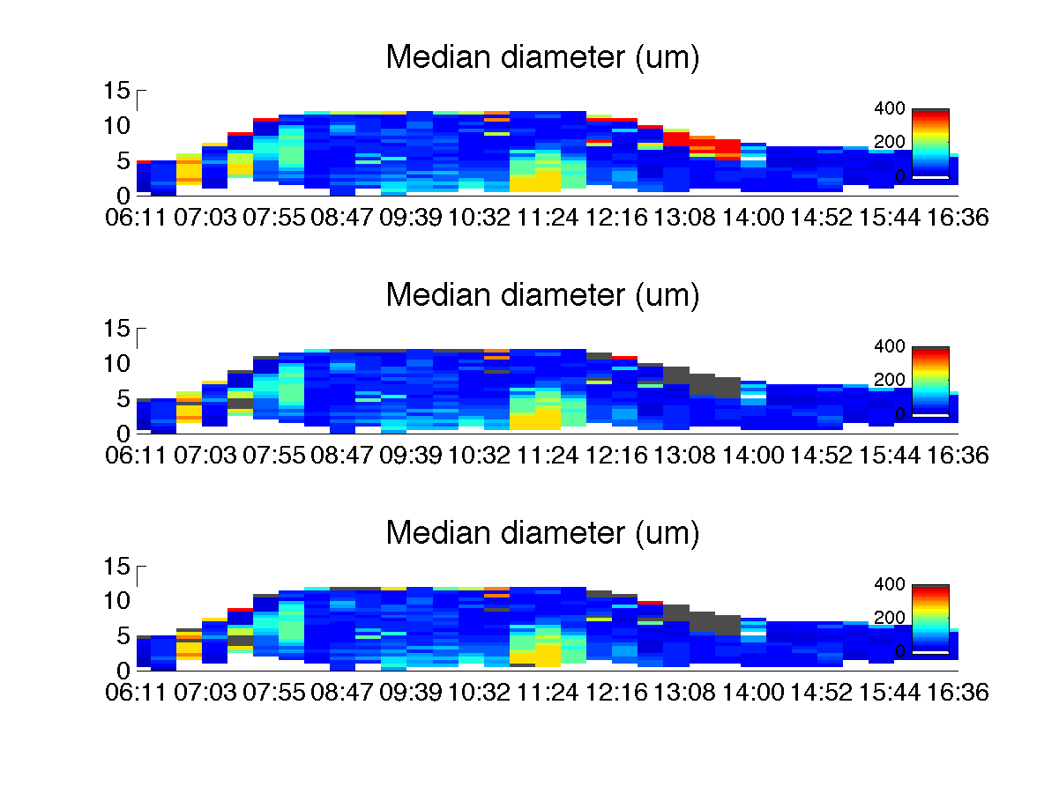
SSC and Acoustic sensors
Main question : how estimating M?
Option 2 : Direct calculation
In both cases : particle size (α_{s}), density (ρ_{s}), sound velocity within the particle (c_{s}) must be known to calculate σ (backscattering cross section) and σ_{tot} (total scattering cross section)

Slide 33
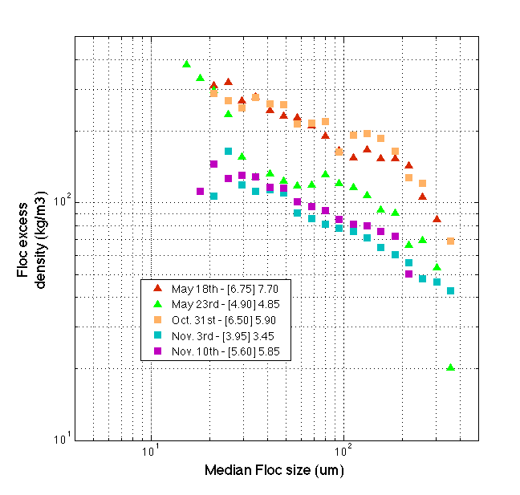
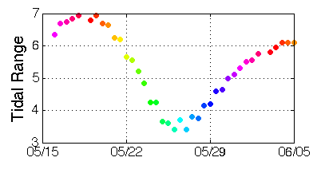
SSC and Acoustic sensors
Main question : how estimating M?
Option 2 : Direct calculation
In both cases : particle size (α_{s}), density (ρ_{s}), sound velocity within the particle (c_{s}) must be known to calculate σ (backscattering cross section) and σ_{tot} (total scattering cross section)

Slide 34
SSC and Acoustic sensors
Main question : how estimating M?
Option 2 : Direct calculation
In both cases : particle size (α_{s}), density (ρ_{s}), sound velocity within the particle (c_{s}) must be known to calculate σ (backscattering cross section) and σ_{tot} (total scattering cross section)
Different models to calculate σ and σ_{tot}…
The most popular, adapted from Sheng and Hay (1988) by Thorne and Hanes (2002), and designed for sand particles
But in estuaries and coastal seas…suspended sediments are rarely sands and mostly fine cohesive sediments, aggregated in flocs (microflocs/macroflocs)
We used a model proposed by Stanton (1998), developped for low density spheres, as flocs are, and including the variability of density of these particles with size, from the fractal approach developped by Kranenburg.
Another possibility is to use the hybrid model proposed by Thorne et al., 2014, which combine small dense sphere for small particles, like microflocs, and fluid spheres as macroflocs are.

Slide 35
SSC and Acoustic sensors
Main question : how estimating M?
Option 2 : Direct calculation
In both cases : particle size (α_{s}), density (ρ_{s}), sound velocity within the particle (c_{s}) must be known to calculate σ (backscattering cross section) and σ_{tot} (total scattering cross section)
Backscattering cross section and total scattering cross section : Stanton 1998

Slide 36
SSC and Acoustic sensors
Main question : how estimating M?
Option 2 : Direct calculation
In both cases : particle size (α_{s}), density (ρ_{s}), sound velocity within the particle (c_{s}) must be known to calculate σ (backscattering cross section) and σ_{tot} (total scattering cross section)
Backscattering cross section and total scattering cross section : Stanton 1998
ρ_{w}=1000kg/m³, ρ_{s}=2650kg/m³; c_{w}=1500m/s, c_{s}=5500m/s
nf : 1 to 3, mainly between 1.6 to 2.6
Dp : 2 to 10 μm

Slide 37
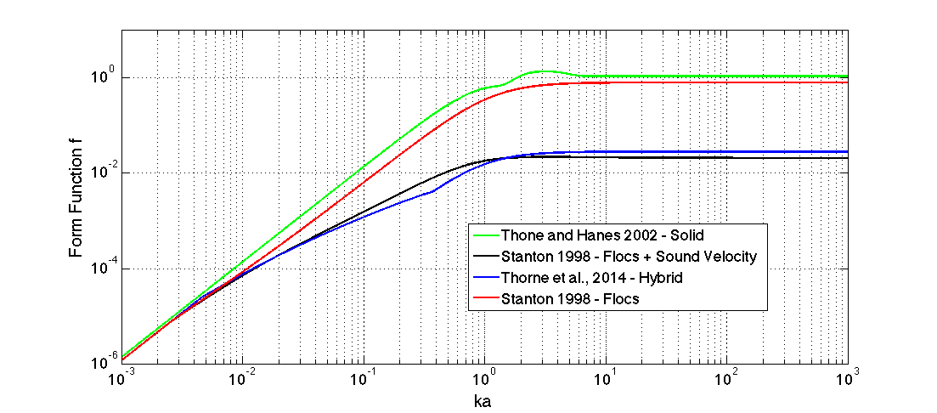
SSC and Acoustic sensors
Main question : how estimating M?
Option 2 : Direct calculation
In both cases : particle size (α_{s}), density (ρ_{s}), sound velocity within the particle (c_{s}) must be known to calculate σ (backscattering cross section) and σ_{tot} (total scattering cross section)

Slide 38
SSC and Acoustic sensors
Main question : how estimating M?
Option 2 : Direct calculation
In both cases : particle size (α_{s}), density (ρ_{s}), sound velocity within the particle (c_{s}) must be known to calculate σ (backscattering cross section) and σ_{tot} (total scattering cross section)
Backscattering cross section and total scattering cross section : Stanton 1998

Slide 39
SSC and Acoustic sensors
Main question : how estimating M?
Option 2 : Direct calculation
In both cases : particle size (α_{s}), density (ρ_{s}), sound velocity within the particle (c_{s}) must be known to calculate σ (backscattering cross section) and σ_{tot} (total scattering cross section)

Slide 40
SSC and Acoustic sensors
Main question : how estimating M?
Option 2 : Direct calculation
In both cases : particle size (α_{s}), density (ρ_{s}), sound velocity within the particle (c_{s}) must be known to calculate σ (backscattering cross section) and σ_{tot} (total scattering cross section)

Slide 41
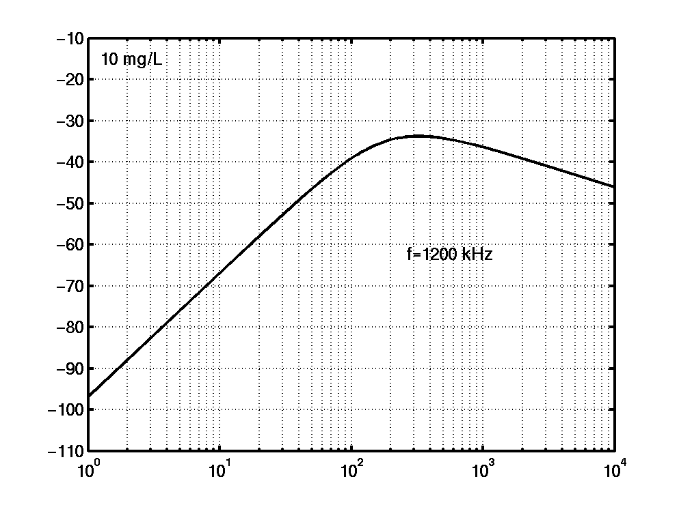
SSC and Acoustic sensors
Main question : how estimating M?
Option 2 : Direct calculation
BI
(dB)
minéral
σ ~ k⁴ a⁶
σ ~ R² a²
Rayleigh
Geometric
particle radius a (µm)

Slide 42
SSC and Acoustic sensors
Main question : how estimating M?
Option 2 : Direct calculation
BI
(dB)
minéral
Effect of frequency
-24 dB
particle radius a (µm)
200 µm
800 µm

Slide 43
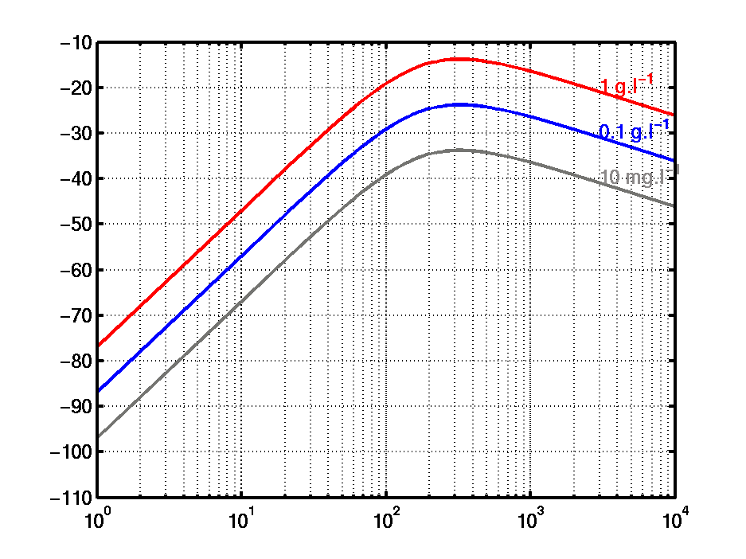
SSC and Acoustic sensors
Main question : how estimating M?
Option 2 : Direct calculation
BI
(dB)
SSC*100 ~ +20 dB
SSC*10 ~ +10 dB
a = 10 µm → 20 µm ~ +10 dB
particle radius a (µm)

Slide 44
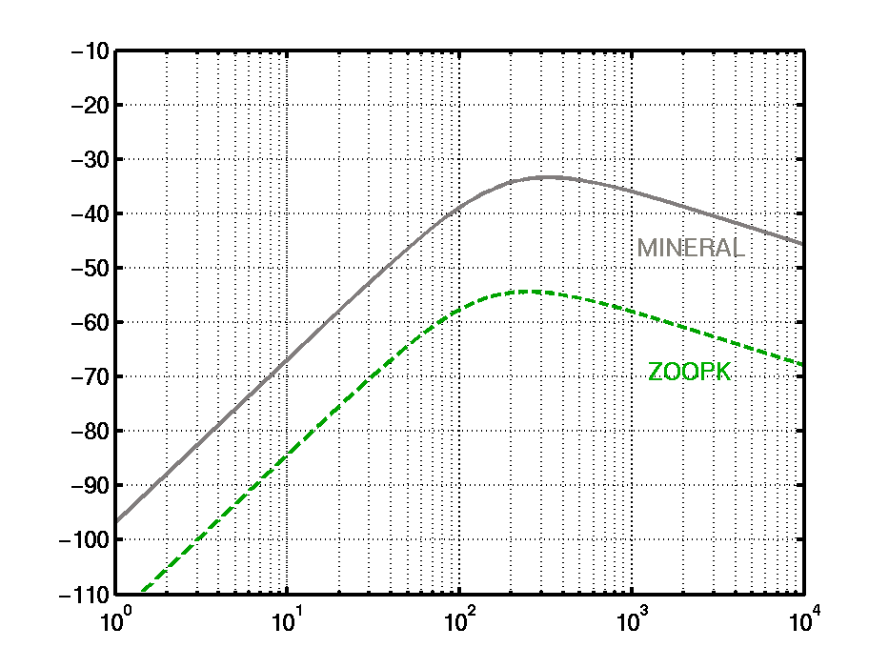
SSC and Acoustic sensors
Main question : how estimating M?
Option 2 : Direct calculation
BI
(dB)
Effect of particles nature (density, elasticity)
~ 15-20 dB
organic
particle radius a (µm)

Slide 45
SSC and Acoustic sensors
Main question : how estimating M?
Option 2 : Direct calculation

Slide 46
SSC and Acoustic sensors
Main question : how estimating M?
Option 2 : Direct calculation
Important point : when considering a PSD, the mean radius that could be used to represent the population is not a volume avearge but a number average…so representative sizes are always small when considering fine sediments, even when large macroflocs are observed

Slide 47
SSC and Acoustic sensors
Main question : how estimating M?
Option 2 : Direct calculation
Range for ka even with flocs…
Important point : when considering a PSD, the mean radius that could be used to represent the population is not a volume avearge but a number average…so representative sizes are always small when considering fine sediments, even when large macroflocs are observed

Slide 48
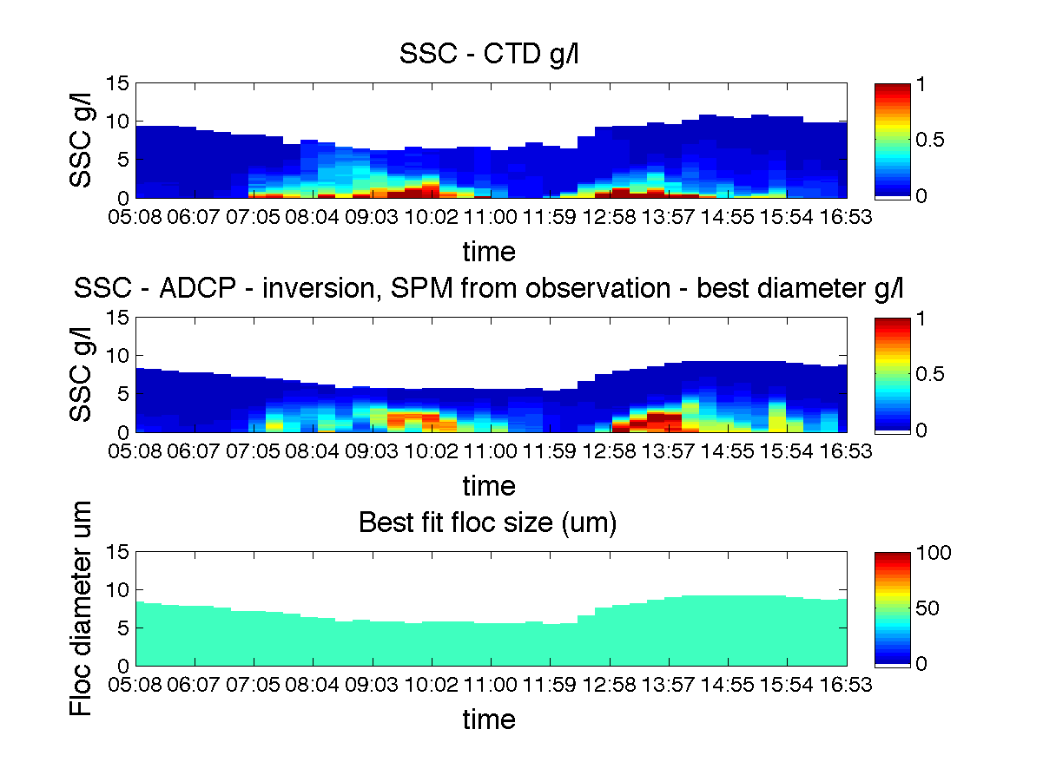
SSC and Acoustic sensors
Main question : how estimating M?
Option 2 : Direct calculation

Slide 49
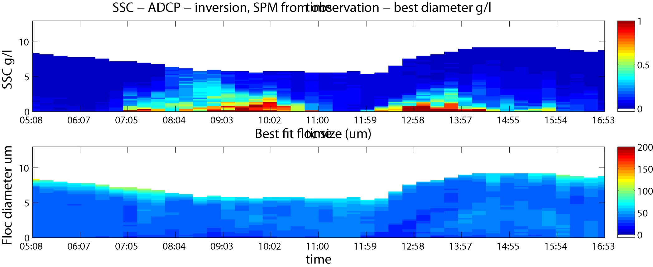
SSC and Acoustic sensors
Main question : how estimating M?
Option 2 : Direct calculation

Slide 50
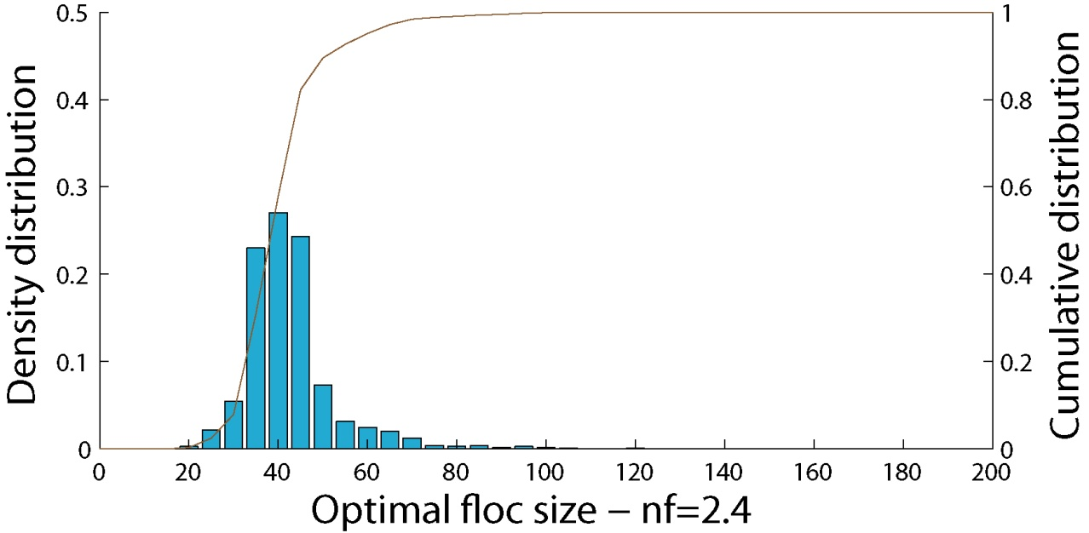
SSC and Acoustic sensors
Main question : how estimating M?
Option 2 : Direct calculation

Slide 51
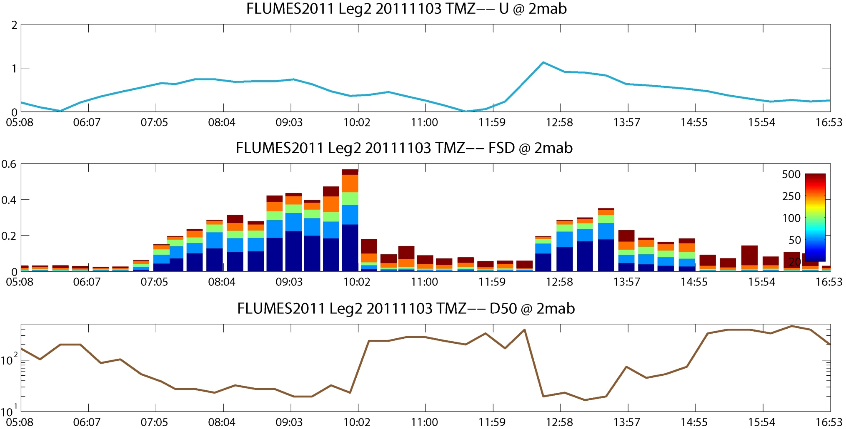
SSC and Acoustic sensors
Main question : how estimating M?
Option 2 : Direct calculation

Slide 52
SSC and Acoustic sensors
Main question : how estimating M?
Option 2 : Direct calculation
With a fixed prescribed size : 40μm

Slide 53
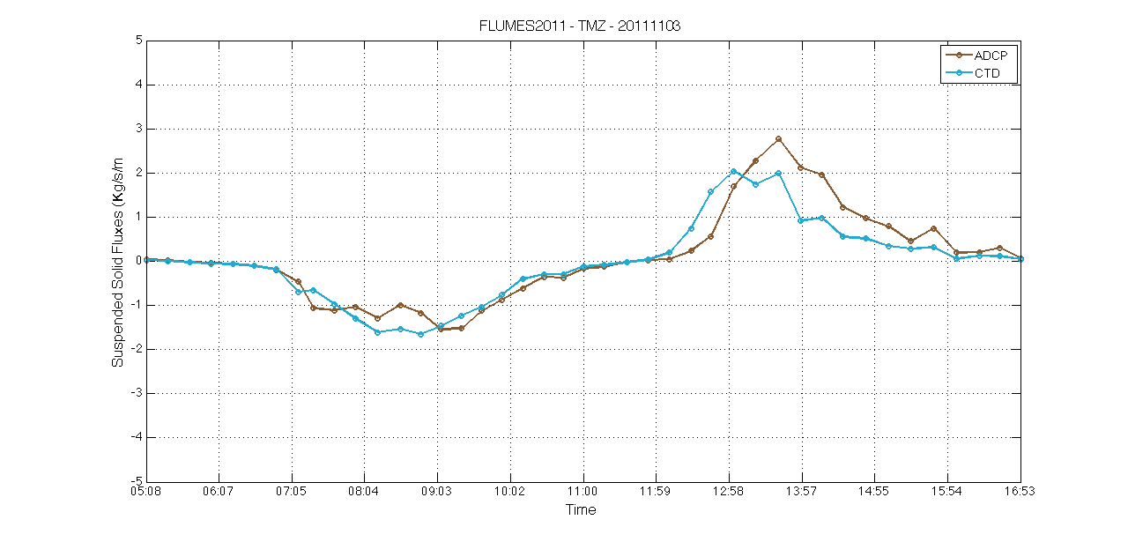
SSC and Acoustic sensors
Main question : how estimating M?
Option 2 : Direct calculation

